Slide 1

Blockchain technology.
Bitcoin
Anastasia Yarovikova IU9-61B
Notes:
1. Table of contents
2. Introduction
3. Our company
4. Our team
5. Problem
6. Them vs. us
7. Solution
8. SWOT analysis
9. Product overview
10. Our plans
11. Product demo
12. Traction
13. Case study
14. Reviews
15. Awards
16. Market size
17. Target
18. Competitors
19. Business model
20. Timing
21. Predicted growth
22. Investment

Slide 2
Presentation plan
01
02
03
04
Blockchain
Bitcoin
What is blockchain technology? The origin Where it is used? Why?
The network and its cryptocurrency. It’s working
Bitcoin analysis
Analysis tools
The importance and the necessity of bitcoin analysis
Increasing the convenience when working with cryptocurrencies

Slide 3
Blockchain technology
Record-keeping technology
Distributed ledger system
Immutable records
User connected to this system has access to the whole data
The information is stored in different blocks that are linked in a sequence and thus this technology is termed Blockchain

Slide 4
Benefits
TRUST SECURITY
Increased transparency
No third-party involvement
Permanent
ledger
Accurate
data

Slide 5
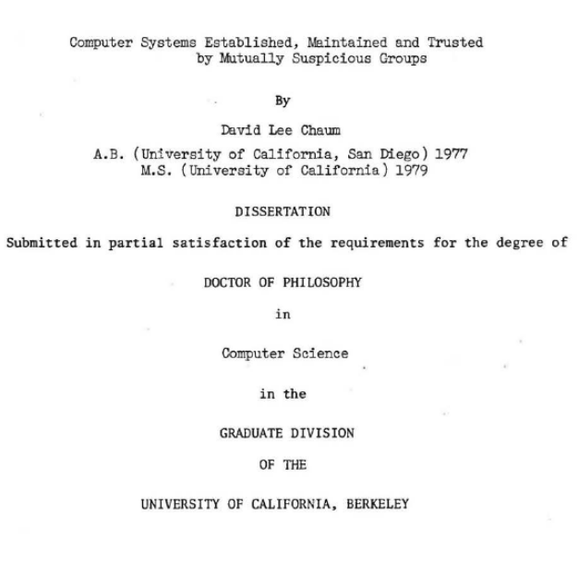

Origin
1982
Cryptographer David Chaum - the idea of the protocol of Blockchain
…
2008
Satoshi Nakamoto - the idea came into reality in the year

Slide 6
“What is needed is an electronic payment system based on cryptographic proof instead of trust,
allowing any two willing parties to transact directly with each other without the need for a trusted
third party.”
— Satoshi Nakamoto

Slide 7

A picture is worth a thousand words

Slide 8
Bitcoin
Cryptocurrency - a medium of exchange created and stored electronically on the blockchain, using cryptographic techniques to verify the transfer of funds and an algorithm to control the creation of monetary units
Has no physical form, no intrinsic value
Its supply is determined by the protocol

Slide 9
Bitcoin Blockchain Operation

Slide 10
Bitcoin network operation 1
P2p network
Verified transaction
1
3
The requested translation is broadcast to the network
It involves cryptocurrency and other information
Request
Validation
One requests transaction
2
Network validates the transaction
4

Slide 11
Bitcoin network operation 2
New block for ledger
The
transaction
is completed
4
6
The transaction is combined with other transactions
Verified transaction
New block is added to the blockchain
5
7

Slide 12
in simple terms
01
03
Bitcoins are in a wallet ( address 1),
Transaction, Its validation
Addition to existing blockchain
02
04
The transaction is completed,
Bitcoins are in a wallet ( address 2)
Combining with transactions, New block

Slide 13
18,900,000
18.9 million Bitcoins in circulation

Slide 14
Bitcoin Blockchain Analysis. The necessity
!
!
!
!
Fake exchanges
Hacking
Phishing emails
Other types of fraud
70% of services are hacked
to obtain wallet data

Slide 15
Tools
Market participants need to keep track of all their trades
Bitcoin blockchain participants need to keep track of all their funds

Slide 16
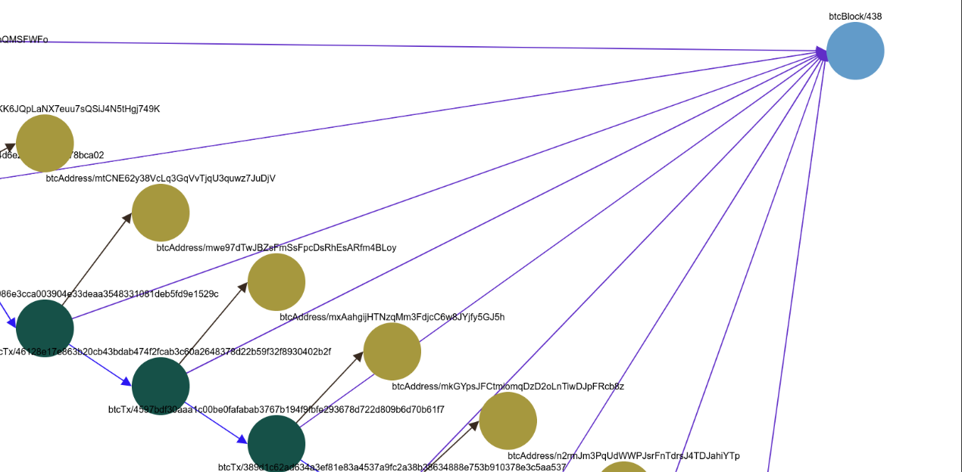
Bitcoin blockchain graph visualization

Slide 17
Awesome Words

Slide 18
Thank you!
Do you have any questions?

